Slide 1
Mass Spectrometry Isotope Patterns
PC Workshop - Introductory Skills and Practical 2
Dr. Alan M. Lewis
Checkin: 672070

Slide 2
VLE Page:
Introductory Skills and Practical 2 > PC Sessions
> Mass Spectrometry
Setup:
Download 3 Python (.py) files.
Create a new folder and move all 3 Python files into it.
Open Powershell by holding shift, right clicking in the folder, and selecting “Open Powershell here”.
Find a pen and paper
Checkin: 672070

Slide 3
Isotope Patterns in Mass Spectrometry
Every element has isotopes: atoms with the same number of protons and different numbers of neutrons.
E.g. ~99% of carbon atoms are ¹²C;
~1% are ¹³C.

Slide 4
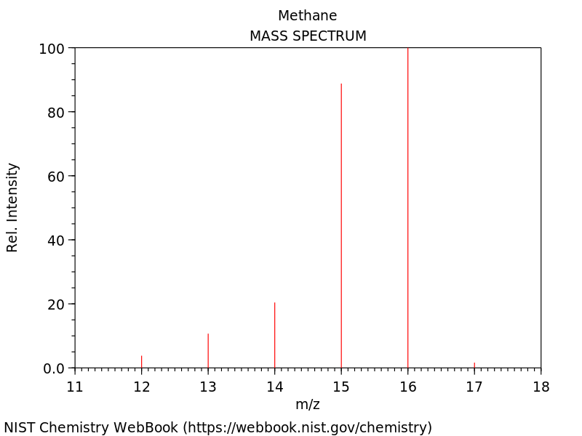
Isotope Patterns in Mass Spectrometry
Every element has isotopes: atoms with the same number of protons and different numbers of neutrons.
E.g. ~99% of carbon atoms are ¹²C;
~1% are ¹³C.
This affects the mass spectrum we see in mass spectroscopy:
Small M+1
peak

Slide 5
1 minute activity
Sketch the mass spectrum of HCl.
Assume all H atoms have mass 1, 75% of Cl atoms are ³⁵Cl, and 25% are ³⁷Cl.

Slide 6
Multiple isotopes in a molecule
Every element has isotopes: in a molecule we need to think about all possible combinations of isotopes.

Slide 7
Multiple isotopes in a molecule
Every element has isotopes: in a molecule we need to think about all possible combinations of isotopes.
E.g. C₂H₆
Probability of ¹²C₂H₆: 0.99² ≅ 0.98
Probability of ¹²C¹³CH₆: 0.99 x 0.01 x 2 ≅ 0.02
Probability of ¹³C₂H₆: 0.01² ≅ 0.00

Slide 8
Multiple isotopes in a molecule
Every element has isotopes: in a molecule we need to think about all possible combinations of isotopes.
E.g. C₂H₆
Probability of ¹²C₂H₆: 0.99² ≅ 0.98
Probability of ¹²C¹³CH₆: 0.99 x 0.01 x 2 ≅ 0.02
Probability of ¹³C₂H₆: 0.01² ≅ 0.00
(See “Calculating peak intensities method 2”, NJW lecture 2)

Slide 9
1 minute activity
Sketch the mass spectrum of Cl₂.
Assume 75% of Cl atoms are ³⁵Cl, and 25% are ³⁷Cl.

Slide 10
100 minute activity
Sketch the mass spectrum of C₆₀.
Assume 99% of C atoms are ¹²C, and 1% are ¹³C.

Slide 11
100 minute activity
Sketch the mass spectrum of C₆₀.
Assume 99% of C atoms are ¹²C, and 1% are ¹³C.

Slide 12
Calculating Mass Spectra
Computers are faster at maths than us!
I have written a Python program which will calculate each of the probabilities. In Powershell, type:
python ms_pattern.py
This should produce two files:
isotope_pattern.png
isotope_pattern.csv
The first is the plot of the mass spectrum; the second is the raw data used to make the plot. Open the .png file - does the spectrum look right?

Slide 13
Calculating Mass Spectra
This is a good start! We want to:
label the axes properly.
scale every peak so the largest peak has intensity 100.
Open ms_pattern.py in Notepad++ and try to make these changes.
We relabeled axes last time - find the “PLOTTING DETAILS” section.
Find the “DATA MANIPULATION” section. The numpy function to find the maximum value in a list is np.max(y). You might also find this list of functions helpful.
Remember to save the python file and re-run using PowerShell to test!

Slide 14
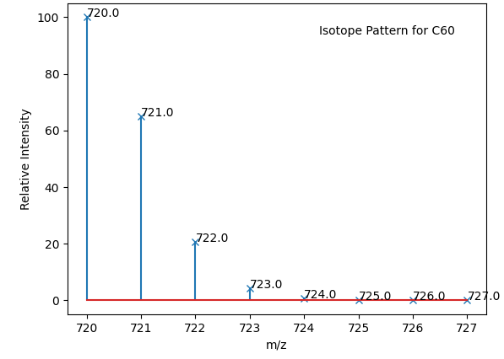
Calculating Mass Spectra
You should have a spectrum which looks like this:

Slide 15
Favourite Molecule 1
We can use this program to predict the isotope pattern of any molecule.
Open ChemDraw and draw your favourite molecule which you can make out of only C, H, N, and O atoms.
Use View > Show Analysis to get the formula for your molecule.
Copy that formula into the ‘mol’ variable in ms_pattern.py.
(Optional) Change the variable fname to change the name of the png file and csv file you will make - if not your old file will be overwritten. Suggestion: add + mol to the end of the line - what will this do?
Run ms_pattern.py in PowerShell and check your new spectrum looks like you expect it to.

Slide 16
Favourite Molecule 2
We can use this program to predict the isotope pattern of any molecule.
Open ChemDraw and draw your favourite molecule which includes at least one atom which is not C, H, N, or O.
Use View > Show Analysis to get the formula for your molecule.
Copy that formula into ms_pattern.py, changing the ‘mol’ variable.
(Optional) Change the variable fname.
Run ms_pattern.py in PowerShell: you will get an error message!

Slide 17
Understanding Python Errors
Traceback (most recent call last):
File "???/ms_pattern.py", line 49, in <module>
atom_data = np.array(data[atom])
KeyError: 'Cl'

Slide 18
Understanding Python Errors
Traceback (most recent call last):
File "???/ms_pattern.py", line 49, in <module>
atom_data = np.array(data[atom])
KeyError: 'Cl'
Need to find the data variable:
from isotope_data import data
Need to find the isotope_data file!

Slide 19
Understanding Python Errors
Open isotope_data.py in Notepad++.
data = {
'H' : [(1.007825, 99.9885),(2.014102, 0.0115)],
'C' : [ (12.0, 98.93),(13.003355, 1.07)],
'N' : [(14.003074, 99.632),(15.000109, 0.368)],
'O' : [(15.994915 , 99.757),(16.999132, 0.038),(17.999160,0.205)]
}
This is a dictionary. We need to add an entry for any elements which are missing! Use Nick’s isotope abundance chart, or if you’ve picked something unusual this detailed table.

Slide 20
Favourite Molecule 2
Once you have updated (and saved!) isotope_data.py, rerun ms_pattern.py. It should now run without any errors!
Extra Exercise: How many isotopologues can you write down which will contribute to your M+1 peak?

Slide 21
High Resolution Mass Spectrometry
So far we’ve always rounded our isotope masses to the nearest whole number. What if we don’t do that?
Open ms_pattern.py and change the resolution variable to 3. This is the resolution we can expect using a ToF spectrometer.
Before you rerun ms_pattern.py, try and answer the following questions:
How many “M+1” peaks will there be in the high resolution spectrum?
Which “M+1” peak will be the most intense (the first, second, third, ...)?
Rerun ms_pattern.py, and view your plot. It’s hard to tell the answers!

Slide 22
High Resolution Mass Spectrometry
Two ways to check our answers:
Open the raw data file and check the numbers
Replot the spectrum in just the region of the M+1 peaks by adding plt.xlim(left=a,right=b) to ms_pattern.py in the appropriate place, and choosing sensible values of a and b.
Try and get the answers by both methods!

Slide 23
High Resolution Mass Spectrometry
We can use high resolution mass spectrometry to identify molecules which have the same rounded weight. E.g. C₂H₈N₂, C₃H₈O (see NJW lecture 2).
The accurate mass of the M peak tell us which elements are in a molecule and how many of each element.
I’ve written a program which predicts the molecule from the mass!

Slide 24
High Resolution Mass Spectrometry
Create a high resolution spectrum of your Favourite Molecule 1 (only C, H, N, O atoms).
Tell the person next to you the mass of the first peak in the spectrum.
Run python ms_solve.py mass where you replace the word mass with mass you have been given - does it correctly identify the molecule?
Will this work with a low resolution mass? Try it and see!

Slide 25
Low Resolution M+1 Challenge
To finish, a challenge for you! In groups of 4-5, choose a heteroatom which must be included in your molecule. Make sure you add the correct isotope abundances for this heteroatom to your isotope_data.py file.
The Challenge: Create a real molecule using ChemDraw with the low resolution M+1 peak as close to 20% relative intensity as possible. Whoever gets closest wins!
Nick’s isotope abundance chart, or this detailed abundance table.

